Slide 1
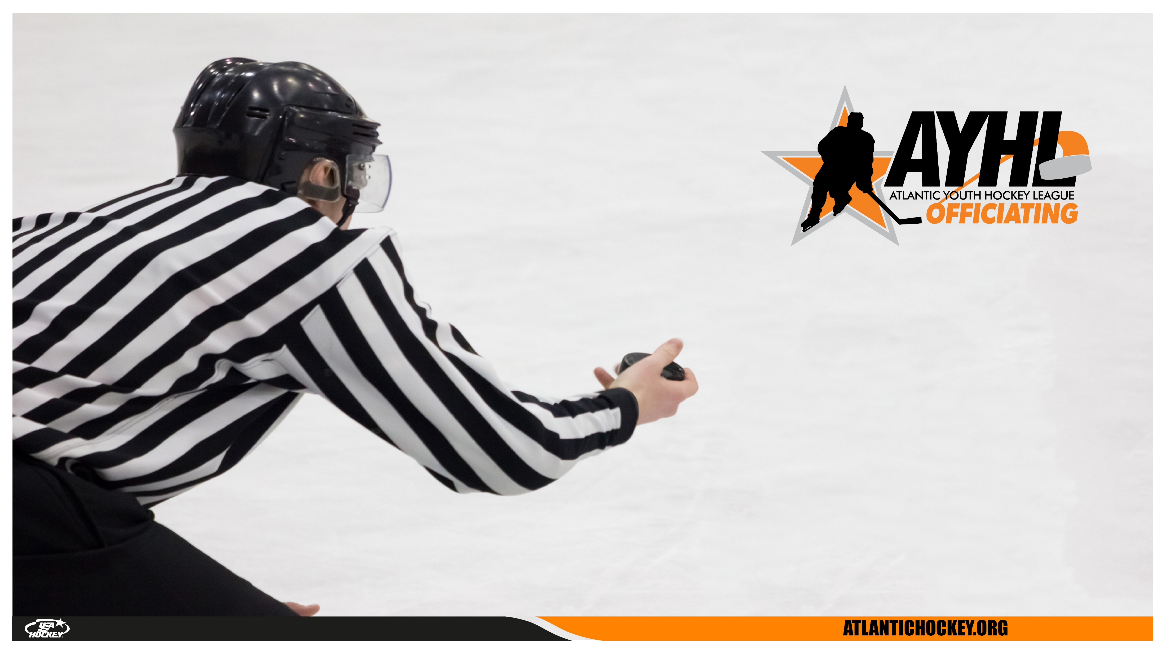
USA HOCKEY OFFICIATING SEMINAR
OFFICIATING
OFFICE
HOURS

Slide 2

WHAT
- Rule Knowledge
- First Hand Experience from Guest Speakers
- Video Discussion
- Development Opportunities
- Feedback & Coaching
- Open Forum for Questions
WHY
- Rule changes and current trends in officiating.
- Sharpen your decision-making and positioning
on the ice.
- Learn from analysis of game situations
- Network and build relationships with fellow
referees.
OFFICE HOURS
usahockey.co
atlantic-district.org

Slide 3

Meeting #1 2/4/25
Guest Speaker
2. Meeting #1 Topic:
Body Language
3. Q and A + Group Discussion
Next Meeting Date and Topic
  March 4th, 2025 7:30-8:30pm EST
  Topic: TBD
AGENDA
usahockey.co
atlantic-district.org

Slide 4
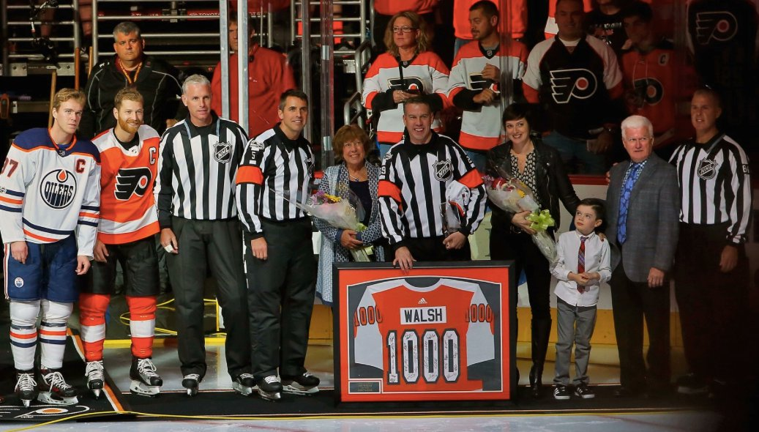
IAN WALSH
PHILADELPHIA, PA
1,321 NHL LEAGUE GAMES
  30 PLAYOFF GAMES
  2 OUTDOOR GAMES
2014 SOCHI OLYMPICS
GUEST SPEAKER
usahockey.co
atlantic-district.org

Slide 5

THANK YOU, IAN!
Final Question:
At what point in time did you become confident in
your own officiating abilities? Did this comfort change
your work ethic?
usahockey.co
atlantic-district.org

Slide 6
  What is Body Language?
  When does it matter?
  Why does it matter?
BODY
LANGUAGE
usahockey.co
atlantic-district.org

Slide 7
Body language is a critical aspect of communication in ice hockey. As a referee, your ability to read players' and coaches' body language and control your own non-verbal cues can influence game flow, reduce conflicts, and build credibility on the ice.
usahockey.co
atlantic-district.org

Slide 8
Why Body Language Matters in Ice Hockey
1. Communication Beyond Words: Referees often communicate through
signals and gestures. Understanding body language enhances clarity.
2. De-escalating Tension: Detecting frustration or aggression early can
help you manage situations before they escalate.
3. Building Credibility: Calm and confident body language establishes
trust and authority.
usahockey.co
atlantic-district.org

Slide 9
Key Elements of Body Language
1. Posture:
- Confident posture (upright, shoulders back) conveys authority.
- Slouched or hesitant posture suggests insecurity or indecisiveness.
2. Facial Expressions:
- Neutral and composed expressions indicate impartiality.
- Frowning or eye-rolling may escalate conflicts.
3. Eye Contact:
- Maintaining appropriate eye contact shows confidence and attentiveness.
- Avoiding eye contact can be perceived as weakness or disinterest.
4. Gestures:
- Clear, deliberate hand signals reduce confusion.
- Erratic or unclear gestures can undermine credibility.
6. Movement:
- Calm and purposeful movement conveys control.
- Fidgeting or rushed movements suggest nervousness.
usahockey.co
atlantic-district.org

Slide 10
Reading Body Language on the Ice
1. Players:
- Signs of Frustration: Clenched fists, head shaking, or aggressive stick movements.
- Signs of Injury: Limping, holding a body part, or sudden withdrawal from play.
- Signs of Aggression: Puffing out the chest, intense eye contact, or confrontational
gestures.
2. Coaches:
- Calm Engagement: Relaxed posture, attentive listening.
- Escalating Frustration: Hands on hips, pointing, or animated gestures.
3. Fellow Officials:
- Seeking Assistance: Eye contact or subtle head nods.
- Disagreement: Crossed arms or tense expressions.
usahockey.co
atlantic-district.org

Slide 11
Controlling Your Own Body Language
1. During High-Pressure Situations:
- Breathe deeply to maintain composure.
- Keep your gestures slow and deliberate.
2. When Addressing Players or Coaches:
- Stand tall with feet shoulder-width apart.
- Maintain eye contact and use a calm, steady voice.
3. After Making Controversial Calls:
- Avoid defensive body language (e.g., crossed arms or stepping back).
- Show confidence through upright posture and clear signals.
usahockey.co
atlantic-district.org

Slide 12
CLIPS (if any)
Planned topics:
    New rule changes
Please drop any questions you have in
the chat
OPEN
DISCUSSION
usahockey.co
atlantic-district.org

Slide 13
  March 4th, 2025 7:30-8:30pm EST
  GUEST SPEAKER: SHANE GUSTAFSON
  (IIHF, AHL, ECHL)
  MEETING #2 TOPIC: Planning for next season- current state and future state.
  Sign up here: https://forms.gle/wU3FfbesG7mLUJv79
  Survey: https://forms.gle/MujXS6dDL871brQV7
NEXT
SESSION
usahockey.co
atlantic-district.org

