Slide 1
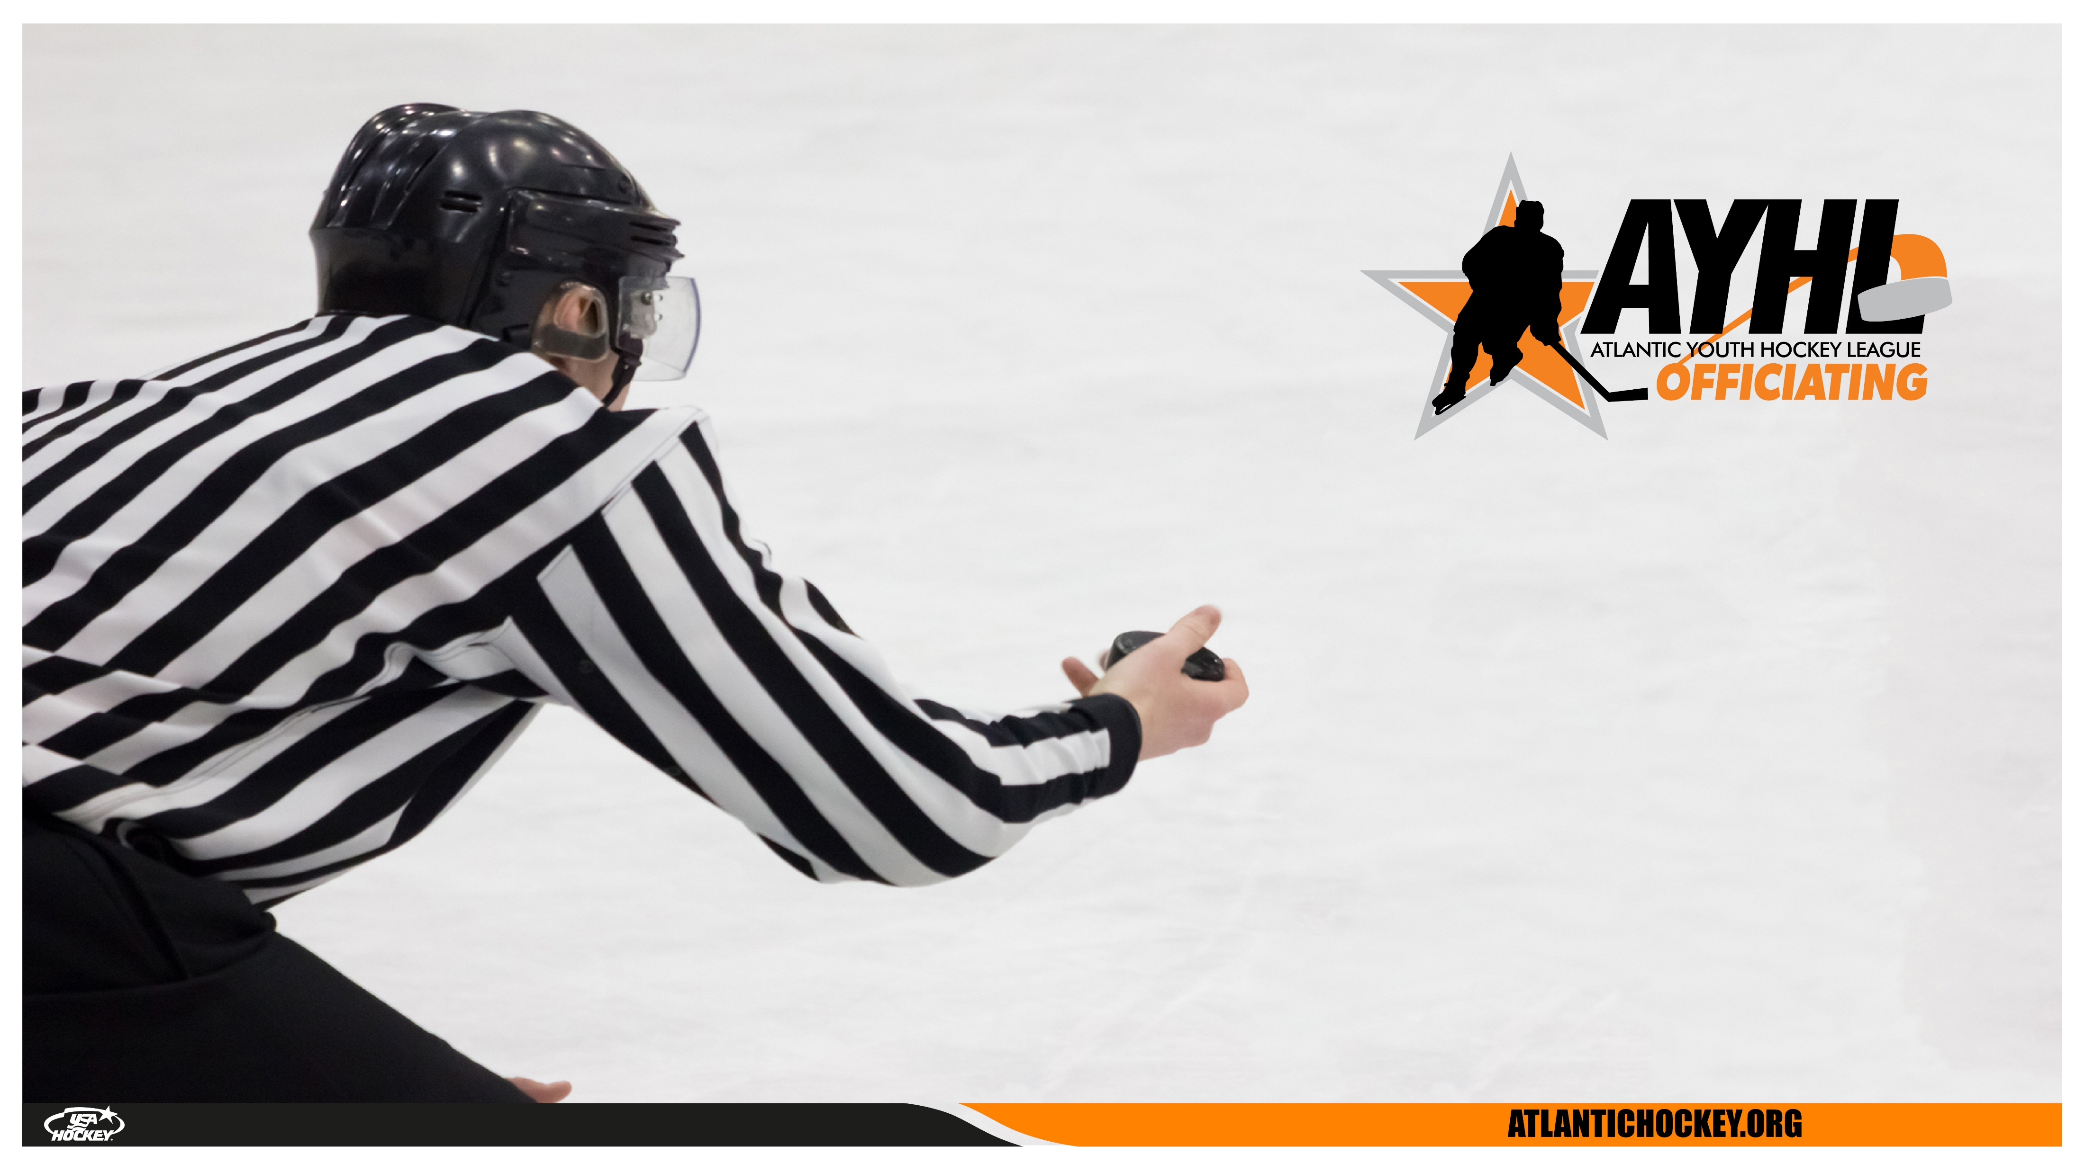
USA HOCKEY OFFICIATING SEMINAR
OFFICIATING
OFFICE
HOURS

Slide 2

WHAT
- Rule Knowledge
- First Hand Experience from Guest Speakers
- Video Discussion
- Development Opportunities
- Feedback & Coaching
- Open Forum for Questions
WHY
- Rule changes and current trends in officiating.
- Sharpen your decision-making and positioning
on the ice.
- Learn from analysis of game situations
- Network and build relationships with fellow
officials.
OFFICE HOURS
usahockey.co
atlantic-district.org

Slide 3

Meeting #2 2/11/25
Guest Speaker
NAHL Officiating Exposure Experience & AYHL Summer Workshops
3. New Rules
Next Meeting Date and Topic
  April 8th 2025 7:30-8:30pm EST
  Guest Speaker: Chris Cozzan
  Topic: Goal Setting/Planning for Next Season
AGENDA
usahockey.co
atlantic-district.org

Slide 4
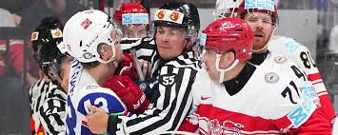
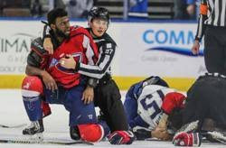
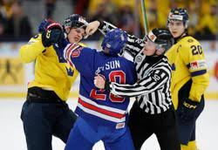
  GUEST SPEAKER: SHANE GUSTAFSON
  (IIHF, AHL, ECHL)
GUEST SPEAKER
usahockey.co
atlantic-district.org

Slide 5
The NAHL Officiating Exposure Experience is designed to provide Education, Exposure, and Experience for officiating prospects looking to develop their skills and advance into higher levels of amateur and junior hockey. This opportunity is operated by the NAHL Officiating Department in partnership with the Atlantic Youth Hockey League (AYHL) and will take place April 4-6, 2025, in Middletown, NJ, alongside the NAHL Combine.
Assignments & Game Fees
- Assignments will be administered by the AYHL. – HWR Group # 206412
-$80/official; two official system
Coaching & Feedback
- Officials will receive on-ice coaching and feedback from experienced Officiating Coaches.
- Each official will receive feedback on at least one game during the event.
Express Your Interest by email me
**Nationals Weekend**
NOEE
usahockey.co
atlantic-district.org

Slide 6
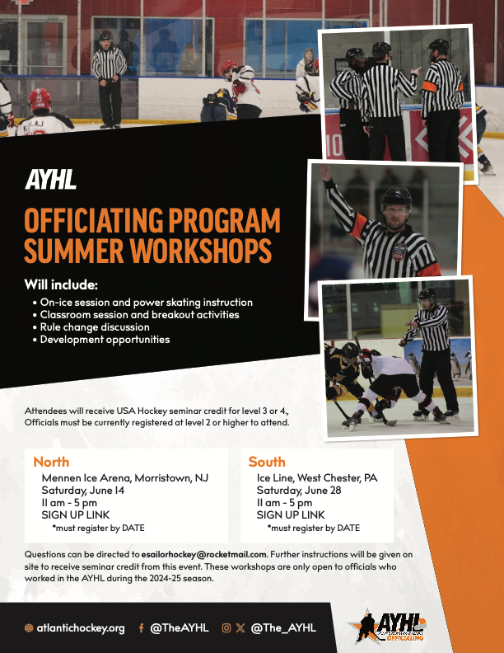

Slide 7
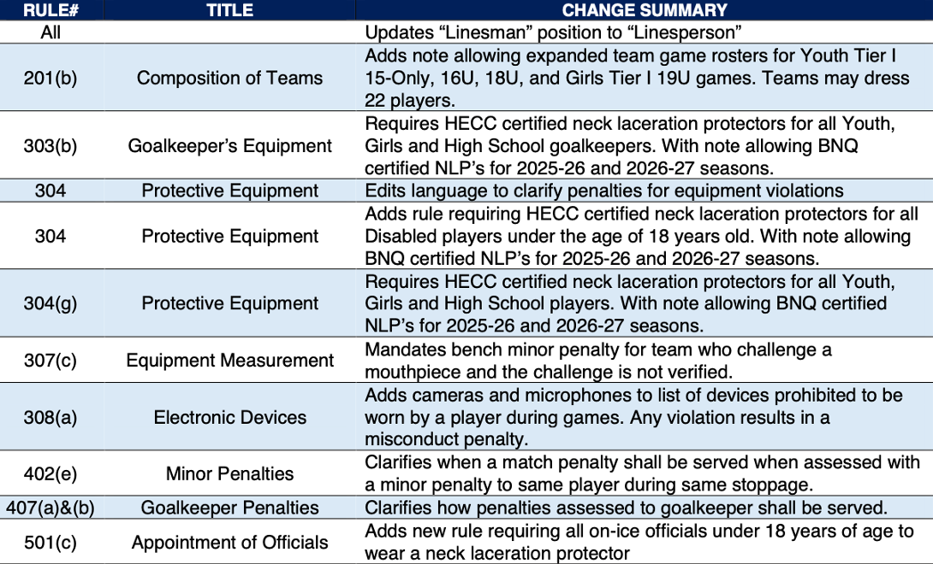
25-26
RULE
CHANGES
usahockey.co
atlantic-district.org

Slide 8
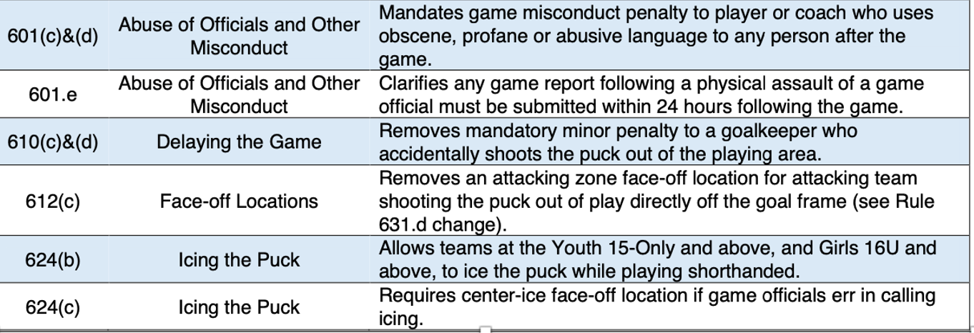
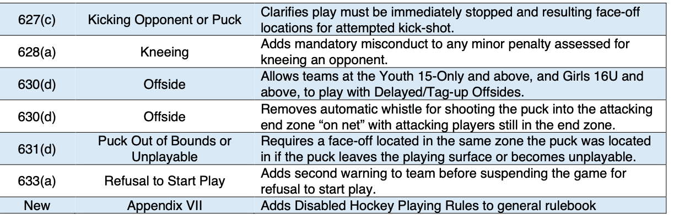
25-26
RULE
CHANGES
usahockey.co
atlantic-district.org

Slide 9
WHAT DO YOU SEE?
WHAT WOULD YOU CALL?
HOLD ON TO YOUR THOUGHTS UNTIL
THE END
VIDEO CLIP
DISCUSSION
usahockey.co
atlantic-district.org

Slide 10
Q & A
WHAT ARE YOU CURIOUS ABOUT?
WHAT CAN WE HELP YOU WITH?
usahockey.co
atlantic-district.org

Slide 11
  April 8th, 2025 7:30-8:30pm EST
  GUEST SPEAKER: CHRIS COZZAN
  Zoom link will be sent to AYHL HWR group the Monday before the session.
NEXT
SESSION
usahockey.co
atlantic-district.org

