Slide 1
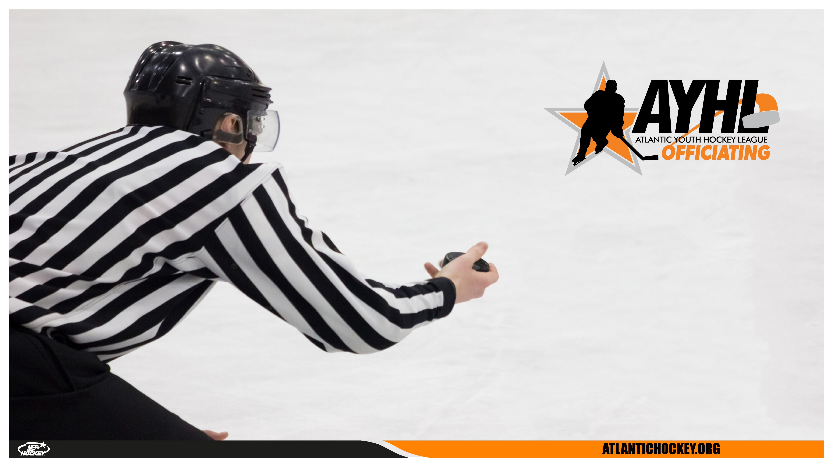
USA HOCKEY OFFICIATING SEMINAR
OFFICIATING
OFFICE
HOURS

Slide 2
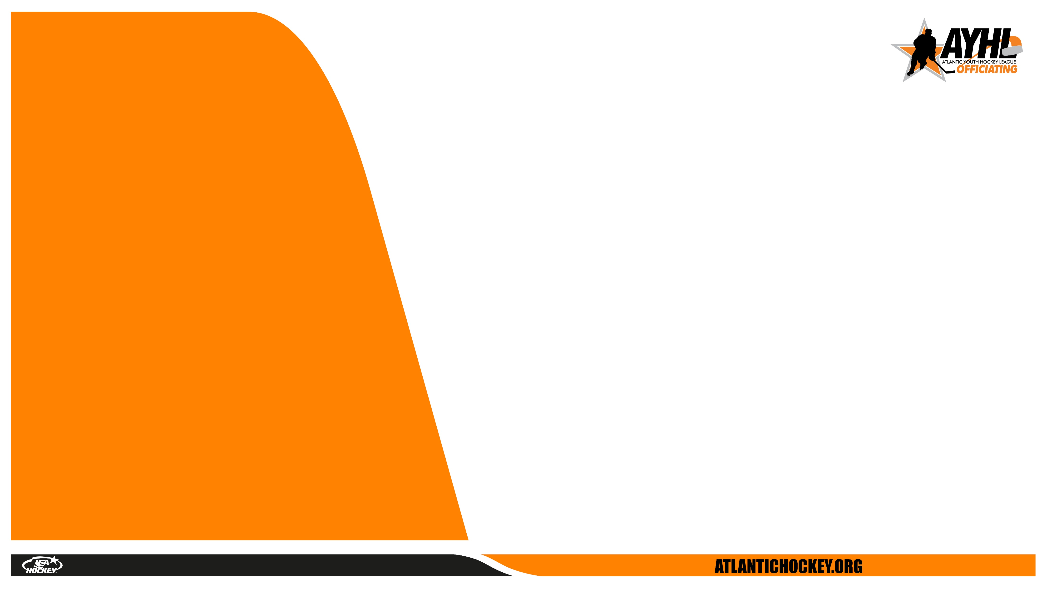
WHAT
- Rule Knowledge
- First Hand Experience from Guest Speakers
- Video Discussion
- Development Opportunities
- Feedback & Coaching
- Open Forum for Questions
WHY
- Rule changes and current trends in officiating.
- Sharpen your decision-making and positioning
on the ice.
- Learn from analysis of game situations
- Network and build relationships with fellow
officials.
OFFICE HOURS
usahockey.co
atlantic-district.org

Slide 3
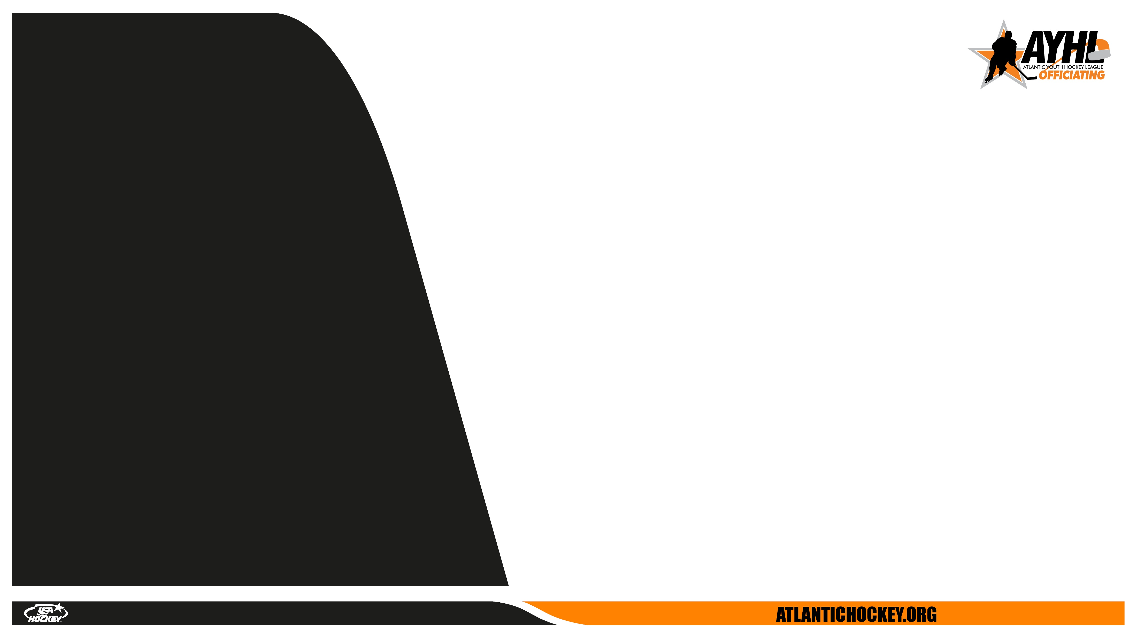
Meeting #3 4/7/2025
Guest Speaker
Season Reflection
& Looking Ahead
3. New Rules
Next Meeting Date and Topic
  August 5th, 2025 7:30-8:30pm EST
  Guest Speaker: JP Waleski
  Topic: Supporting your Referee
AGENDA
usahockey.co
atlantic-district.org

Slide 4
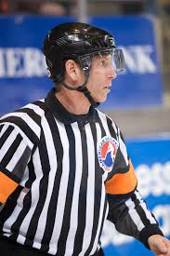
  GUEST SPEAKER: Chris Cozzan
  (AHL, ECHL, NCAA, IHL)
GUEST SPEAKER
usahockey.co
atlantic-district.org

Slide 5
Reflection on the Season
Assess Your Performance – Identify strengths and areas for improvement.
What games went well? Where could you have handled situations better?
Review Feedback – Consider any evaluations from supervisors, assignors,
or fellow officials. What common themes emerged?
Game Management & Communication – Reflect on how you interacted with
players, coaches, and partners. Did you maintain control and professionalism?
Rules & Mechanics – Were there any recurring challenges with positioning,
signaling, or rule application?
REFLECTING
usahockey.co
atlantic-district.org

Slide 6
Moving Forward & Improvement
Set Goals for Next Season – Target specific areas to improve, whether it’s
fitness, rules knowledge, or confidence in game control.
Seek Learning Opportunities – Attend camps, watch higher-level officials,
and study video clips to refine your approach.
Network with Supervisors & Assignors – Keep relationships strong by staying
engaged in the offseason and expressing your interest in continued growth.
Stay in Shape – Maintain your fitness level so you're ready when the next
season begins.
Stay Engaged with the Game – Watching games, discussing scenarios with
fellow officials and staying updated on rule changes can keep you sharp.
LOOKING
AHEAD
usahockey.co
atlantic-district.org

Slide 7
The Game is Always Evolving – Hockey constantly changes with new rule interpretations, faster gameplay, and different coaching strategies. If you’re not improving, you’re falling behind. Staying proactive ensures you remain relevant and capable at higher levels.
Small Gains Lead to Big Opportunities – Even minor improvements in positioning, communication, or game management can separate a good official from a great one. Those who actively seek growth put themselves in position for better assignments, more respect, and greater confidence on the ice.
So what?
usahockey.co
atlantic-district.org

Slide 8
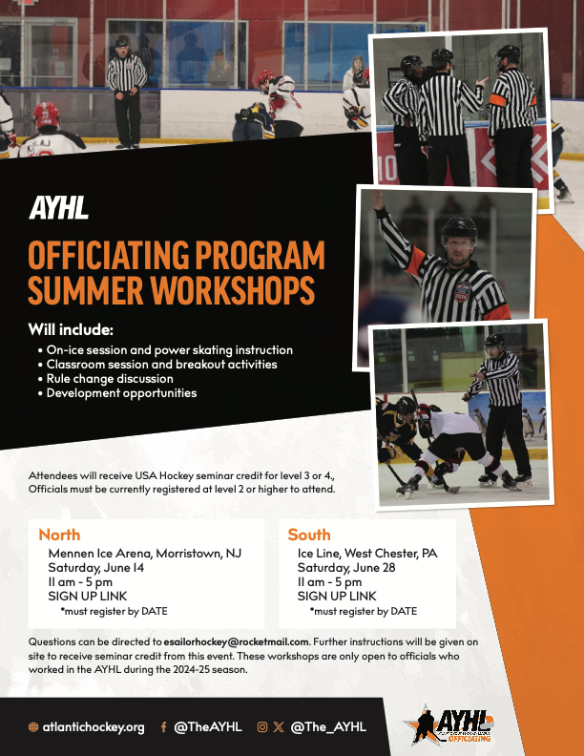

Slide 9
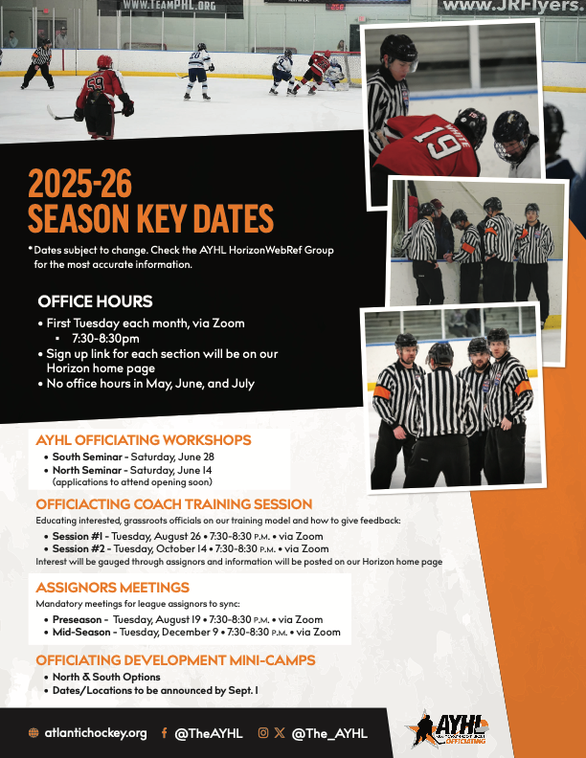

Slide 10
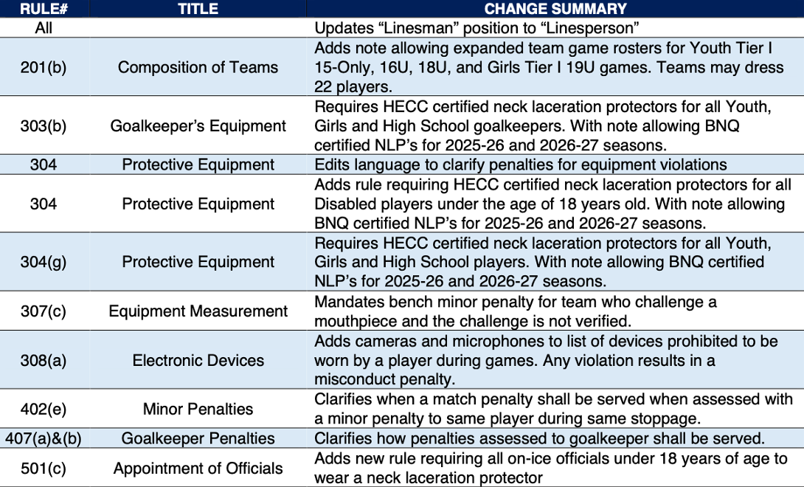
25-26
RULE
CHANGES
usahockey.co
atlantic-district.org

Slide 11
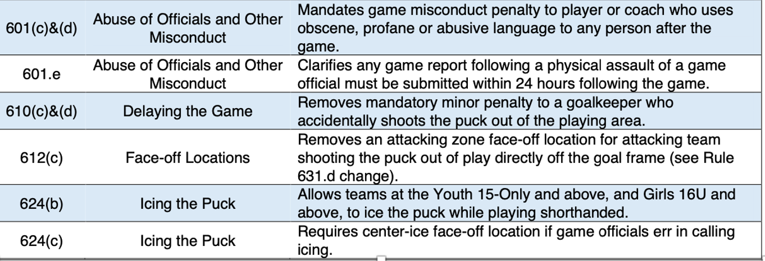
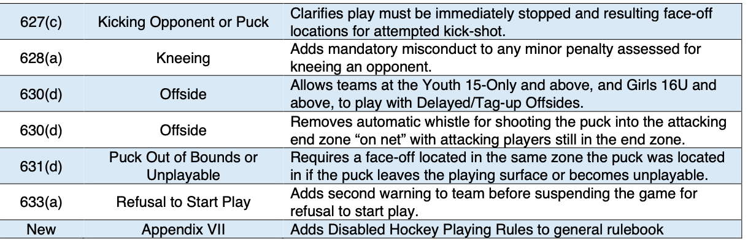
25-26
RULE
CHANGES
usahockey.co
atlantic-district.org

Slide 12
Q & A
WHAT ARE YOU CURIOUS ABOUT?
WHAT CAN WE HELP YOU WITH?
usahockey.co
atlantic-district.org

Slide 13
  August 5th, 2025 7:30-8:30pm EST
  Guest Speaker: JP Waleski
  Topic: Supporting your Referee
  Zoom link will be sent to AYHL HWR group the Monday before the session.
NEXT
SESSION
usahockey.co
atlantic-district.org

